Slide 1
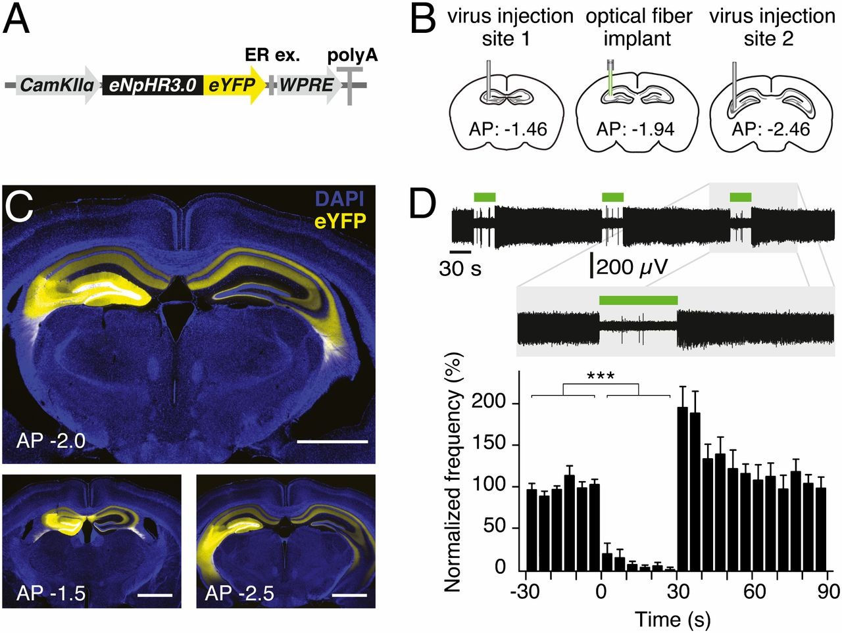

Optogenetics enables acute silencing of CA3 activity in vivo.
Olivia A. Shipton et al. PNAS 2014;111:42:15238-15243
©2014 by National Academy of Sciences
Notes:
Optogenetics enables acute silencing of CA3 activity in vivo. (A) Adeno-associated virus containing the eNpHR3.0-eYFP construct under the control of a CaMKIIα promoter was used. WPRE, woodchuck hepatitis posttranscriptional regulatory element. (B) Virus was unilaterally injected into two sites in the dorsal CA3 area of C57BL/6J mice for use in optrode recordings. For behavioral experiments, an optical fiber was also implanted between the two injection sites. (C) Two-site virus injection resulted in eNpHR3.0-eYFP or eYFP expression in CA3 and CA3 projections in the entire dorsal hippocampus. (Upper) Expression at approximate location of implant. (Lower) Approximate location of two injection sites. (Scale bars, 1 mm.) (D) Illumination of CA3 neurons in eNpHR3.0-expressing mice for 30 s resulted in a reversible reduction in spontaneous spiking frequency. A representative optrode recording trace as well as normalized mean frequency is shown. Error bars represent SEM.

